Slide 1
Collection and Analysis of Health News Data
By: Christopher Singh, Karolina Cieslar, Mohamed Haggag

Slide 2
Introduction
The project was conducted to analyze news articles based on common characteristics found in the text. The New York Times API was used to extract 1000 articles, query applied for the extraction was “Health”. We obtain the article array of 65038 words. Articles were then tokenized and pre-processed using Natural Language Toolkit. We were able to identify most frequent and most important words, create a words vocabulary, discover topics of discussion, create summaries of the articles and determine sentiments of the articles.

Slide 3
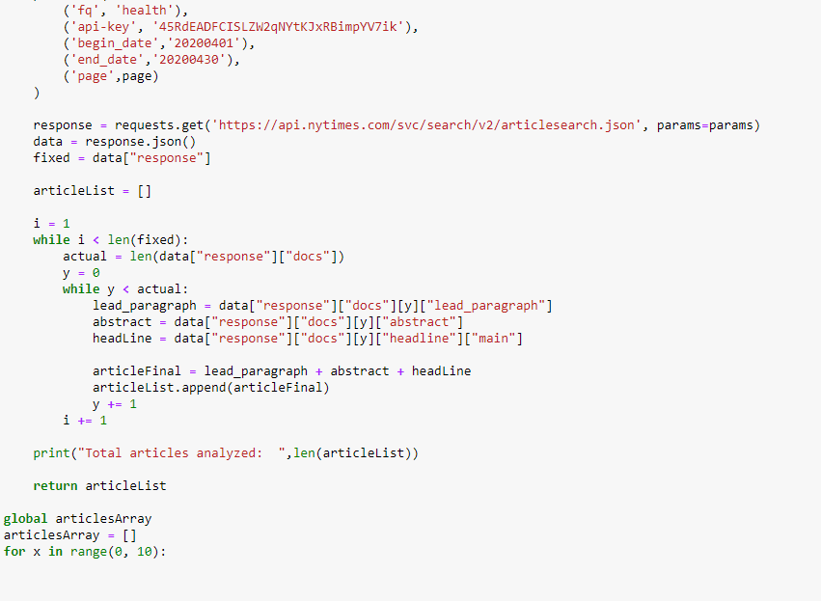
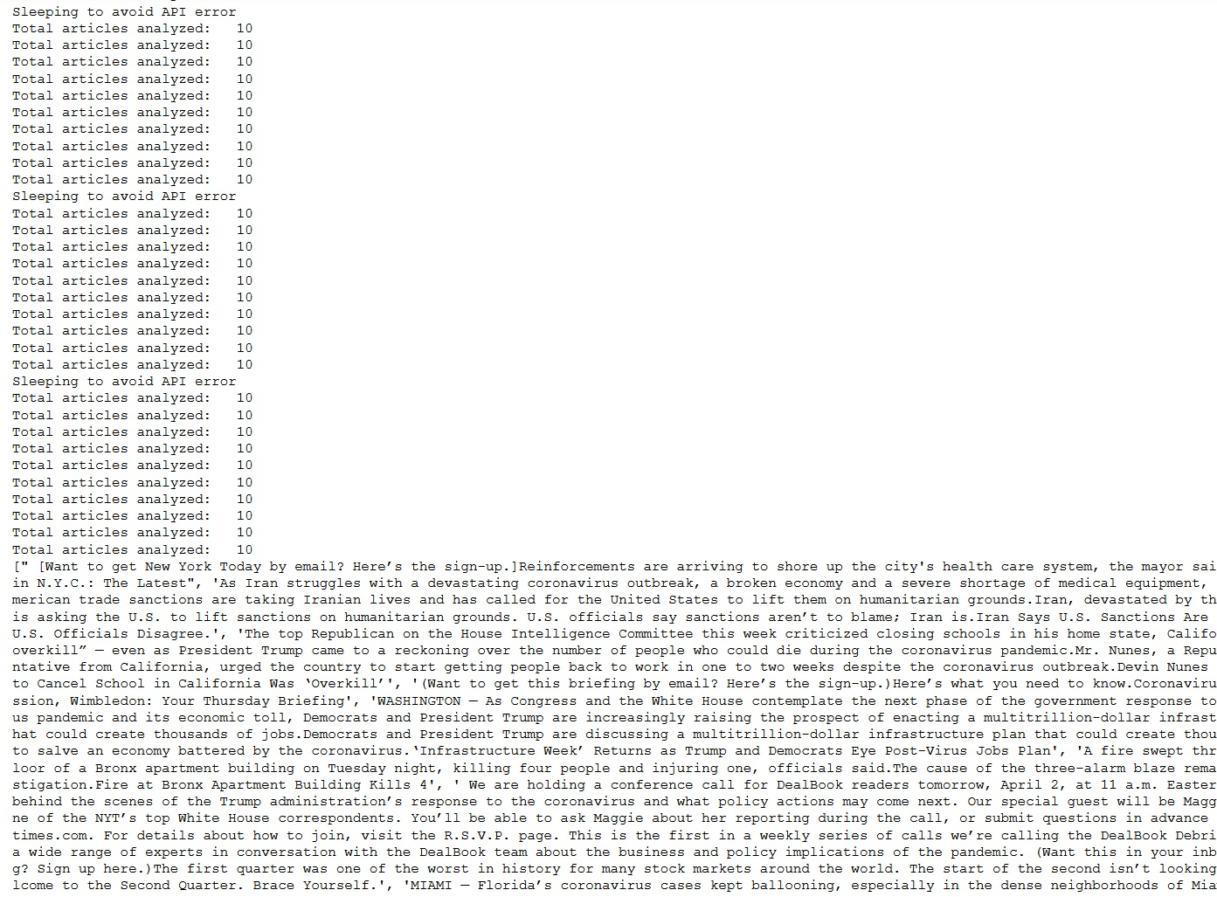
Implementation of NYT API for articles extracting

Slide 4
Pre-Processing
Multi-words were identified and added to the tokens array for more accurate analysis, using NLTK Multi-Word Expressions Tokenizer. As a result we obtain total of 63628 tokens. Then, the articles were pre-processed by removing stop-words, which left us with 37533 tokens. Finally, we applied lemmatization and stemming techniques to the remaining words using Natural Language Toolkit.

Slide 5
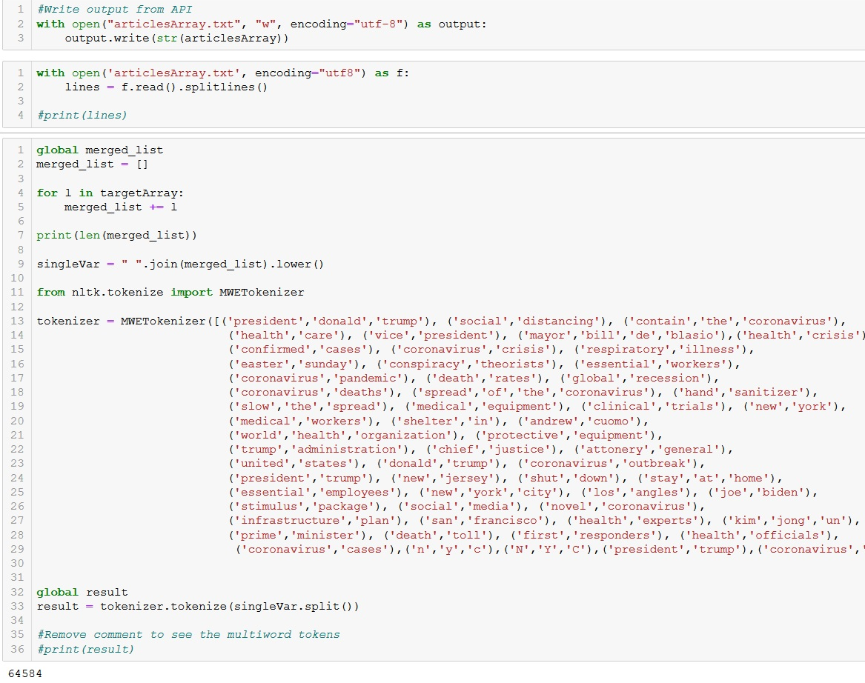
Multi-words expressions were added to the tokens array using MWETokenizer

Slide 6
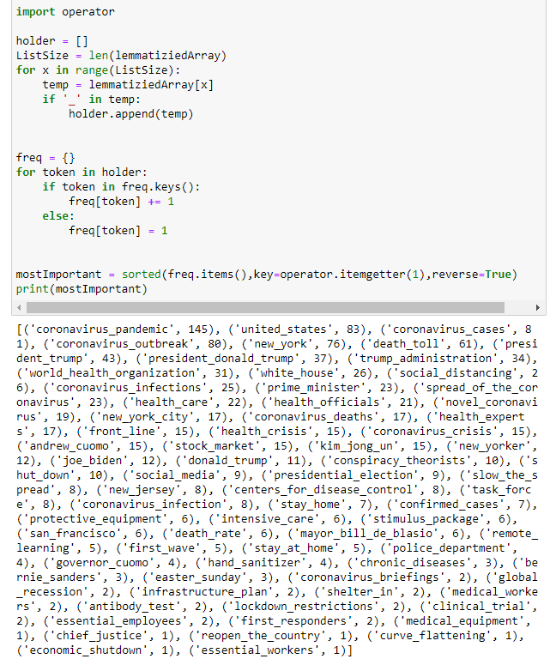

Slide 7
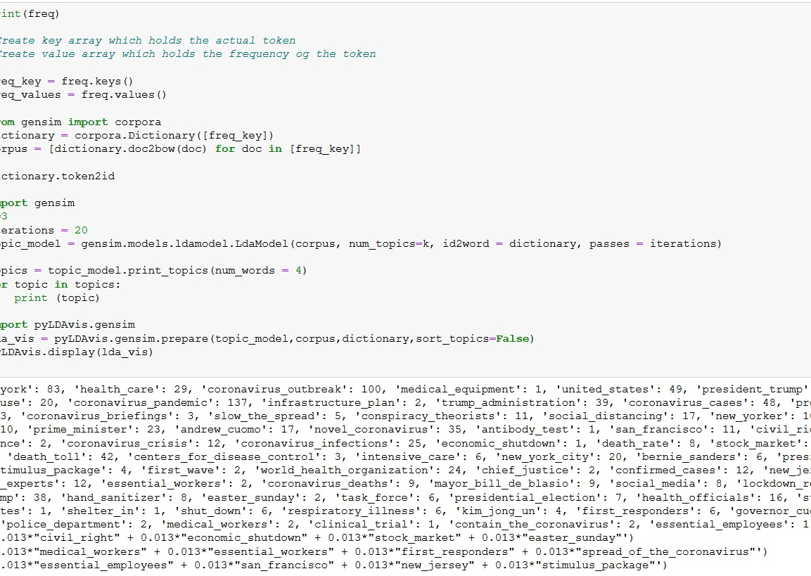
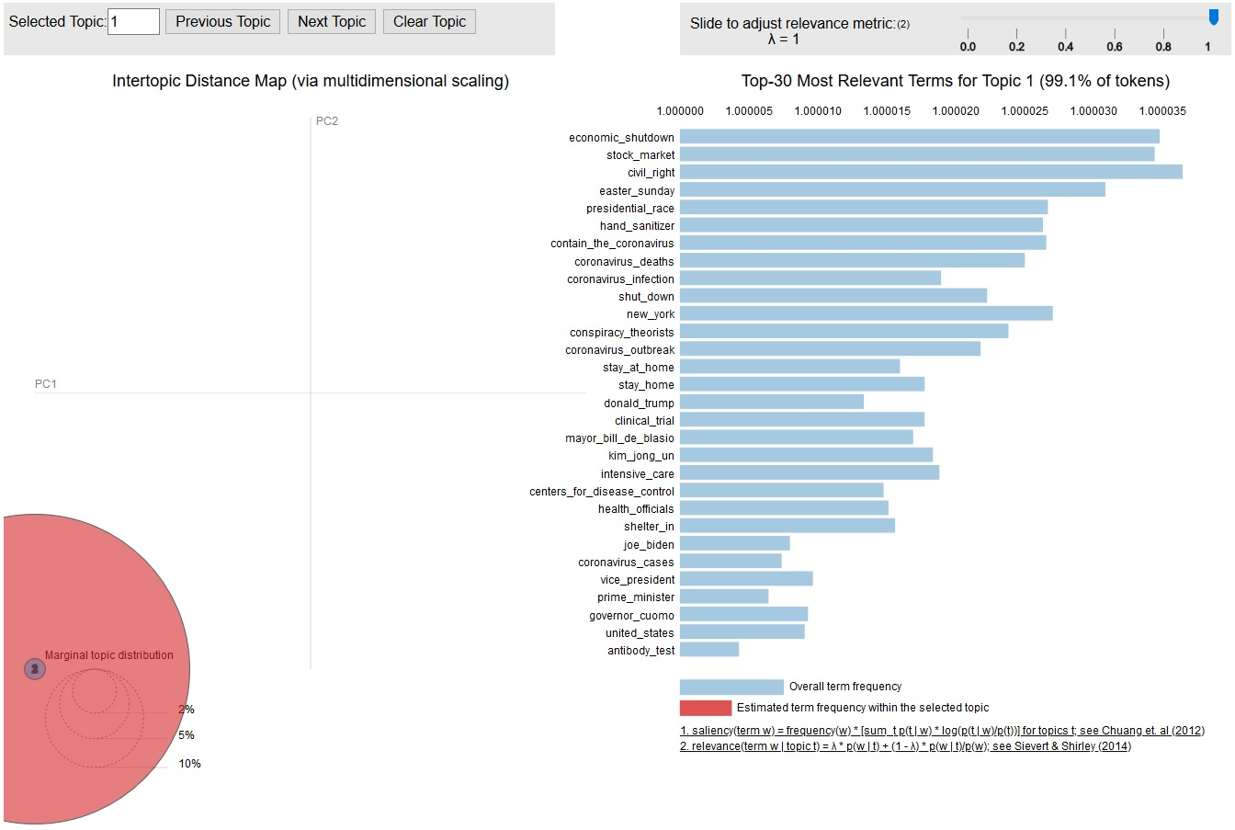
Topics of discussion were found using Latent Dirichlet Allocation (LDA) model, then the results were analyzed and visualized using pyLDAvis package for better understanding and interpreting of each topic.

Slide 8
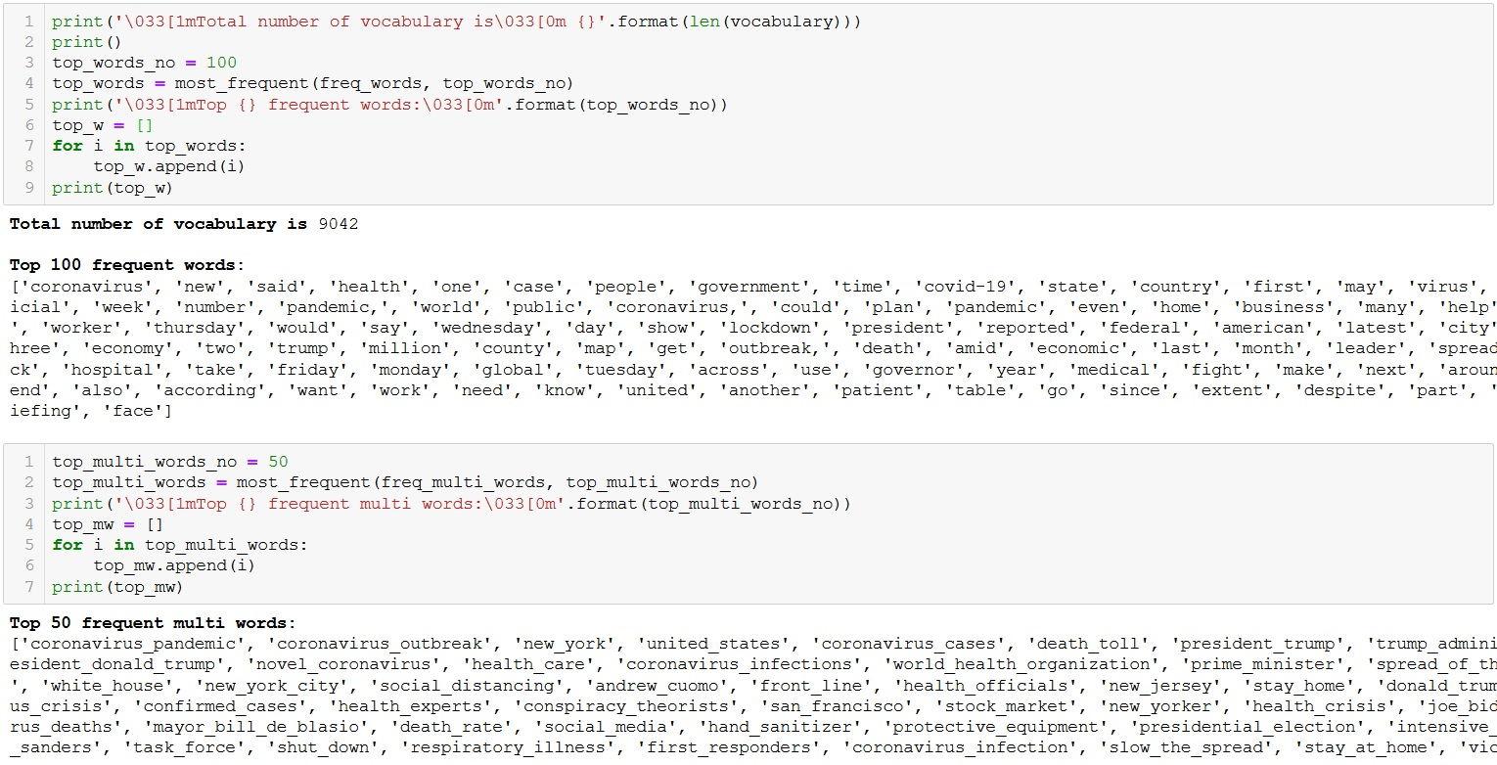
Vocabularies of most frequent multi-words and single-word were created

Slide 9
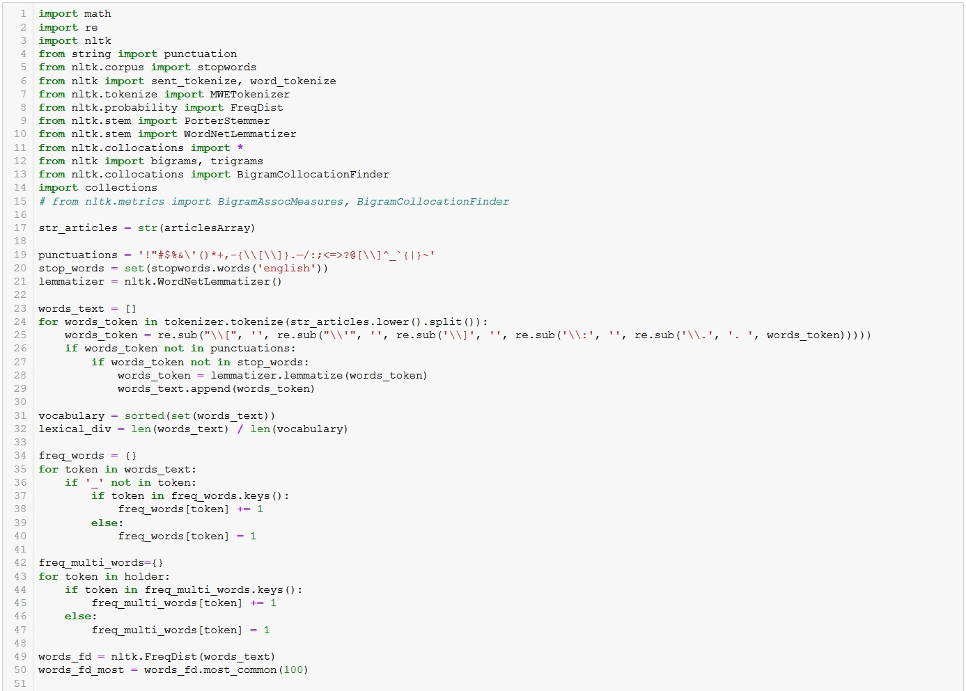
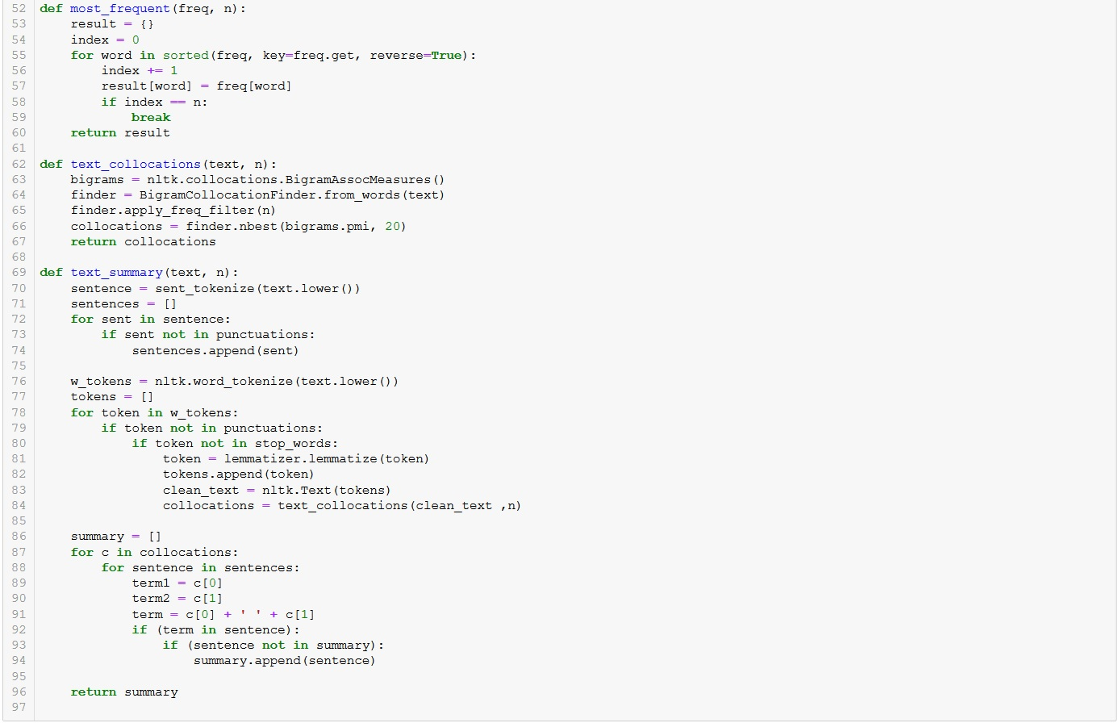
Summaries of the articles were created using previously generated vocabulary of the most frequent terms using collocations by applying NLTK Bigram Collocations finder on all articles and print most important sentences

Slide 10
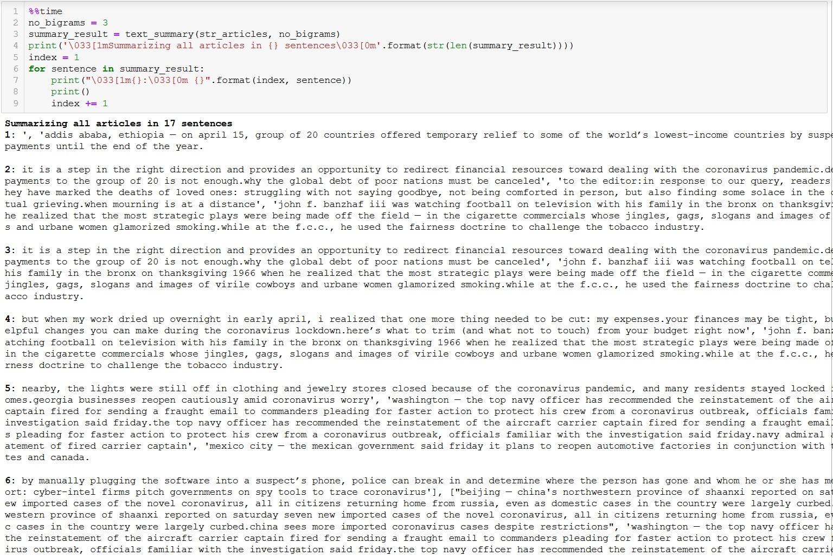
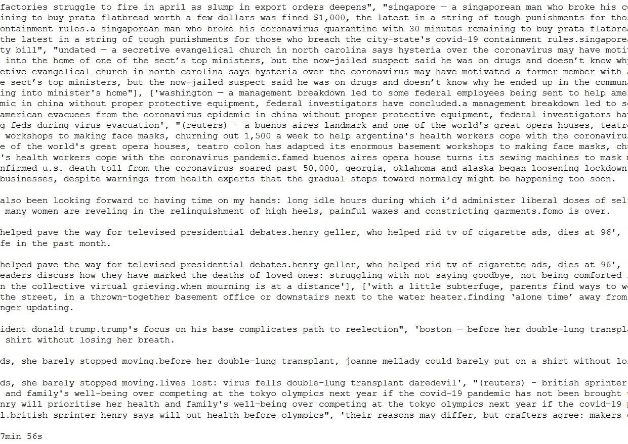
Summaries- output

Slide 11
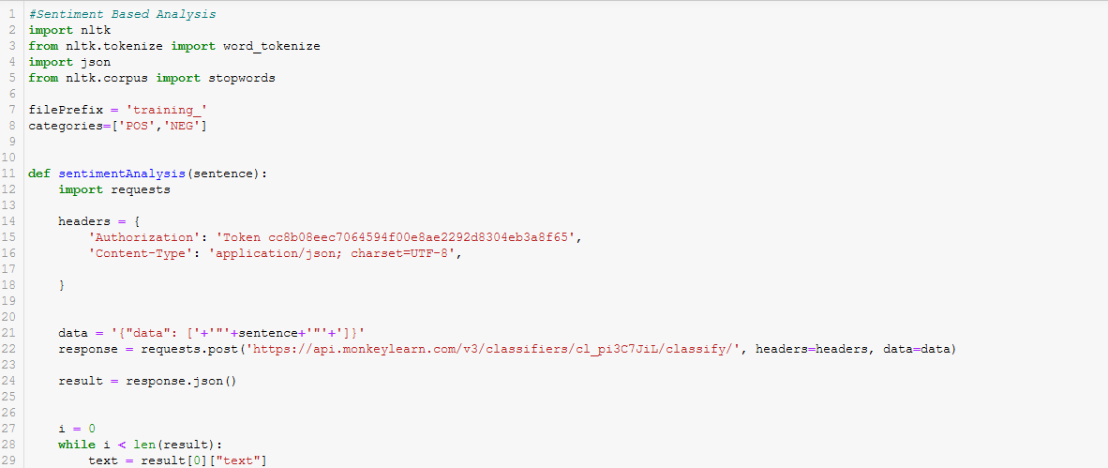
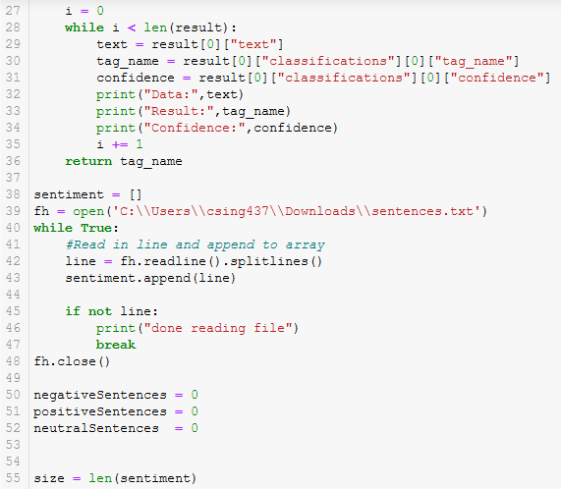
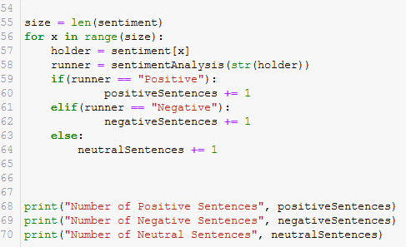
For sentiment analysis, we used Monkey Learn which is a machine learning tool that is open to the community. For each sentence, we hit the Monkey Learn Sentiment Analysis API and it returns whether the sentence is positive, negative or neutral along with a confidence value

Slide 12
